Slide 1
Neural Machine Translation by Jointly Learning to Align and Translate
Implemented English - Vietnamese Translation in PyTorch

Slide 2
What is Attention Mechanism ?

Slide 3
The use of a fixed-length vector is the bottleneck in traditional Encoder-Decoder architecture.
The performance in such a scenario is inversely proportional to sentence length.
Now let’s pay attention to attention mechanism. (Pun unintended)

Slide 4
What’s more humanly approach to translation ?
It’s definitely not to read the entire sentence at once and then translate.
It’s more like pay attention to particular phrases of input and translate accordingly.
This is exactly what the attention mechanism does.

Slide 5
Major Distinguishing Features
It does not encode the whole input in just one vector which is forwarded to decoder.
Instead, it encodes the input sentence into a sequence of vectors and chooses a subset of these vectors adaptively while decoding the translation.
This frees a neural translation model from having to squash all the information of a source sentence, regardless of its length, into a fixed-length vector.

Slide 6
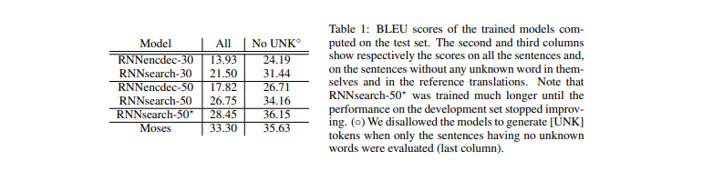
Quantitative Advantage of the proposed model

Slide 7
Word Embeddings
Pre-trained english word embeddings were directly imported from the stanford repository for GloVe.
We used the embeddings of dimension : 200, other options included 50, 100, 300.
As for the words not included in GloVe, we initiated them with random values that got trained later.

Slide 8
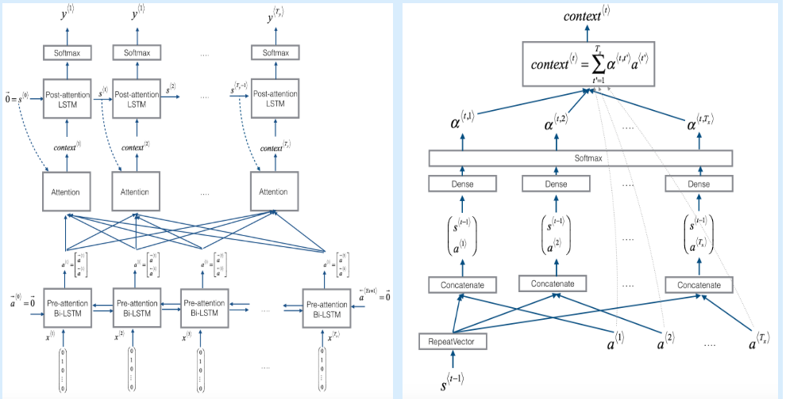
The Model in a nutshell

Slide 9
Background and Preprocessing

Slide 10
Sequence Models by Andrew NG was a major help in developing a deeper understanding of the paper.
The resources provided in the mail were also helpful in gaining familiarity with PyTorch.
Jupyter Notebook tutorials on official webpage of PyTorch were also great sources for reference.
Official Documentation of PyTorch was just as helpful along with a number of Internet articles.

Slide 11
Training dataset : IWSLT’15 English - Vietnamese about 133k sentence pairs, by Stanford NLP group.
Test dataset : Also included in the same package as above, about 1300 sentence pairs.
As the data was pretty much preprocessed already, not much work went into it.
After importing and processing the data,
Unique English words were about 45k
Unique Vietnamese words were about 14k

Slide 12
Encoder and other parameters
We implemented an Encoder class with a Bi-LSTM that outputs two sets of activations per word.
Final annotations for each word are obtained by concatenating the above two tensors.
These activations will be helpful later in calculation of attention vectors.
The final encoder state is given as a starting state to the decoder.

Slide 13
Decoder with Attention
We implemented an AttnDecoder class which uses the previously derived annotations along with the context vectors to output words.
This Decoder is also built of LSTM cells which outputs until the EOS token is reached.
While outputting words using a softmax layer, context vectors for each output are also parallely computed.

Slide 14
These context vectors are a weighted summation of all annotations of the input words.
By the end of the entire translation, we have a weights matrix called attentions that contains a weight for each output word with respect to input word.
This attentions matrix are plotted against the words to get an idea as to how attentions correlate the input and output words.

Slide 15
HyperParameter Tuning and Training
We defined two different functions to train the network, firstly to train an individual sample and second one to run multiple iterations.
The maximum length of output sentence is capped at 100 words to avoid unnecessary loops.
Stochastic gradient optimization is applied at both encoder as well as decoder with learning rate of 0.01
AttnDecoder also trained the word embeddings through a simple neural network using gradient descent.

Slide 16
The default dropout rate is set as 0.1 at the decoder stage.
The loss function at the output softmax layer is Log-Likelihood function.
The back-propagation of losses is made easy to implement by Torch’s backward function coupled with step function of optimizers.

Slide 17
Evaluations and Comparisons
The Evaluate function runs on test data by computing the translation by the above trained network.
It prints both the actual translation and the machine translation for comparison.
We also defined a decoder class without attention to showcase its impact on output.
It finally plots the attention matrices for the sentences which shows correlation between words.

Slide 18
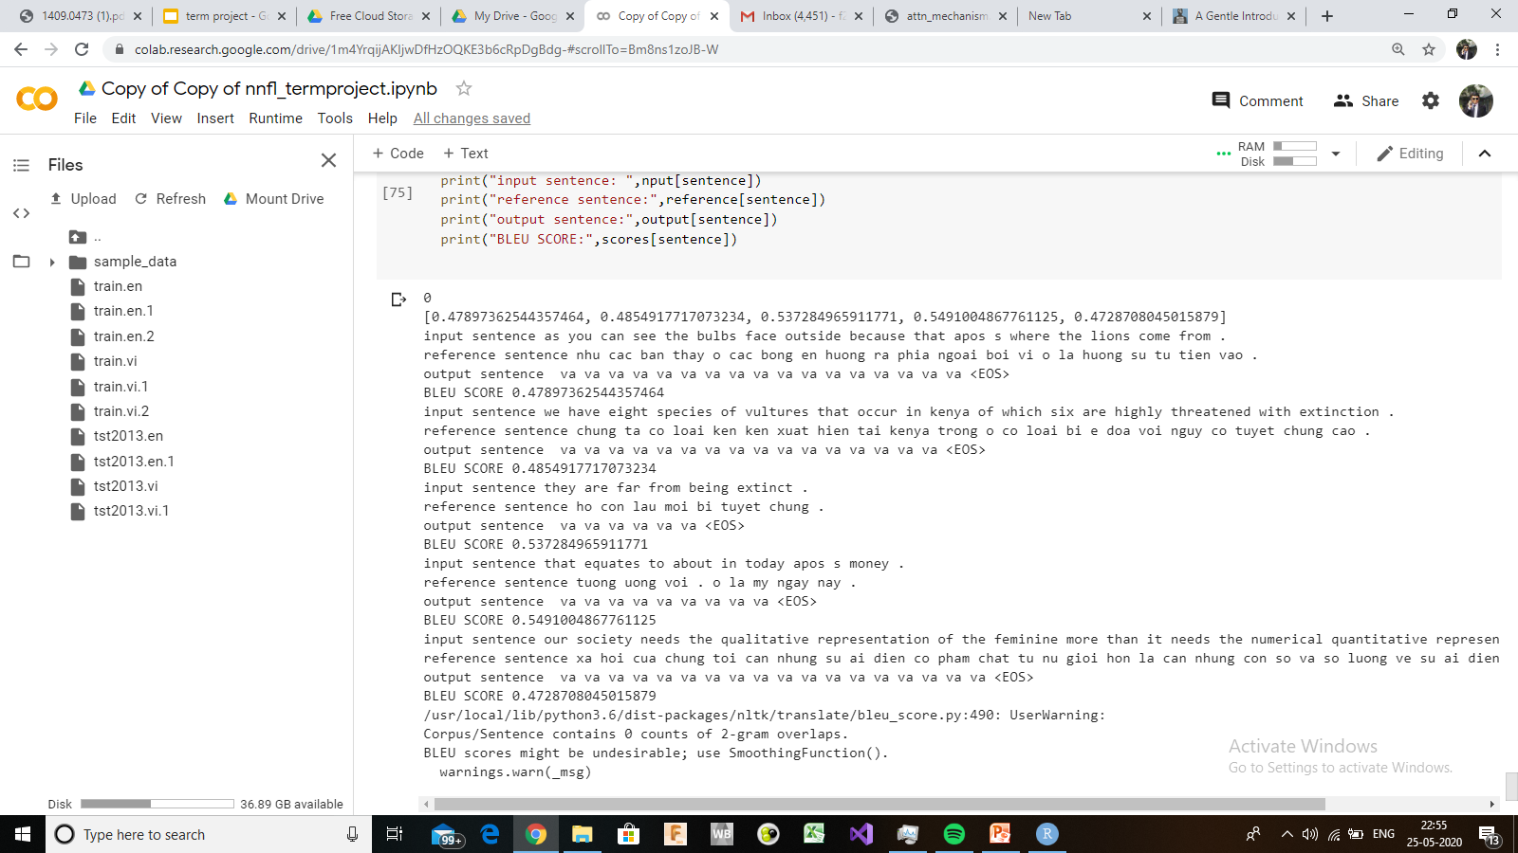
Some Sentences along with bleu scores.

Slide 19
Problems and Shortcomings
Major shortcoming came in the form of actual training.
We could not properly train the network given the shortcomings of using google colab, though using GPU.
This was mostly because the session kept getting idle while put on training for elongated time.
Hence, we had to train from the start every time this occurred .

Slide 20
Conclusion and Future Scope
Variable Length Attention instead of using all the output states of the encoder.
The Attention model s definitely one of the most robust model and has provided for state of the art results.
An ensemble of model has been proven as the best technique for a NMT model.
Still the problem of large sentences is quite prominent but this model at its very least has been a better added advantage then all the previous models

